Slide 1
Chapter 15 : Concurrency Control

Slide 2
Chapter 15: Concurrency Control
Lock-Based Protocols
Timestamp-Based Protocols
Validation-Based Protocols
Multiple Granularity
Multiversion Schemes
Insert and Delete Operations
Concurrency in Index Structures

Slide 3
15.0 Concurrency Control
并发操作可能带来的数据不一致性
  丢失更新(Lost Update)
  不可重复读(Non-Repeatable Read)
  读“脏”数据(Dirty Read)
An Introduction to Database System

Slide 4
15.0 Concurrency Control
丢失更新
两个以上事务从DB中读入同一数据并修改，其中一事务（后提交的事务）的提交结果破坏了另一事务（先提交的事务）的提交结果，导致先前提交事务对DB的修改被丢失。
An Introduction to Database System

Slide 5
11.1 并发控制概述
丢失更新举例:事务T1对数据库的修改丢失了
时间 | T₁ | DB中A值 | T₂ | 注： A=16表示从DB中读入A值。
t1 | 读A=16 | 16 | ……
t2 | …… |  | 读A=16
t3 | 计算A：=A-1 |  | ……
 | 存盘COMMIT | 15
t4 |  | 15 | 计算A：=A-1
 |  |  | 存盘COMMIT
例：售票 1张票卖出两次

Slide 6
15.0 Concurrency Control
不可重复读
不可重复读是指事务1读取数据后，事务2执行更新操作，使事务1无法再现前一次读取结果。具体地讲，不可重复读包括三种情况：
  事务2修改了事务1所读数据，当事务1再次读该数据时，得到与前一次不同的值。
  事务1按一定条件从数据库中读取某些数据记录后，事务2删除了其中部分记录，当事务1再次按相同条件读取数据时，发现某些记录神秘地消失了。（幻读）
  事务1按一定条件从数据库中读取某些数据记录后，事务2插入了一些记录，当事务1再次按相同条件读取数据时，发现多了一些记录。 （幻读）

Slide 7
15.0 Concurrency Control
不可重复读举例(1)
时间 | T₁ | T2
t1 | 读A=50 读B=100 求和=150
t2 |  | 读B=100 B←B*2 写回B=200
t3 | 读A=50 读B=200 求和=250 (验算不对)

Slide 8
11.1 并发控制概述
不可重复读举例(2)（幻读）
时间 | T₁ | T2
t1 | 读S=1 读N＝’张岁丰’
t2 |  | 读S=1 Set S=200501 Where S=1
t3 | Set N=‘张三丰’ Where S=1
 | 事务T1验算结果不正确

Slide 9
15.0 Concurrency Control
读“脏”数据
  事务1修改某一数据，并将其写回磁盘
  事务2读取同一数据后,事务1由于某种原因被撤消.，这时事务1已修改过的数据被恢复原值
  事务2读到的不稳定的瞬间数据就与数据库中的数据不一致，是不正确的数据，又称为“脏”数据。
An Introduction to Database System

Slide 10
15.0 Concurrency Control
产生三类数据不一致的原因
  并发操作破坏了事务的隔离性
  必须对并发的一事务加以控制才能避免此类现象
并发控制机制的任务
  对并发操作进行正确调度
  保证事务的隔离性
  保证数据库的一致性
并发控制的方法
  加锁
  乐观假设
  时间戳
An Introduction to Database System

Slide 11
15.0 Concurrency Control
SQL的隔离级别
  事务准备接受不一致数据的级别称为隔离级别,隔离级别是一个事务必须与其它事务进行隔离的程度
  较低的隔离级别可以增加并发，但代价是降低数据的正确性。
  较高的隔离级别可以确保数据的正确性，但可能对并发产生负面影响。
  应用程序要求的隔离级别确定了 SQL Server 使用的锁定行为

Slide 12
15.0 Concurrency Control
SQL的隔离级别(续) – 从低到高
  可读未提交(Read Uncommitted)
  允许读未提交的记录
  可读提交(Read Committed)
  只允许读已提交的记录，但不要求可重复读
  可重复读(Repeatable Read)
  只允许读取已提交的记录，并要求一个事务对同一记录的两次读取之间，其它事务不能对该记录进行更新
  可串行化(Serializable)
  一个调度的执行必须等价于一个串行调度的结果

Slide 13
15.0 Concurrency Control
隔离级别 | 描述 | 不一致现象
Read uncommitted 未提交读、脏读 | 允许读取未提交的记录 | 读脏数据 不可重复读 幻象
Read committed 提交读 （SQL Server默认的隔离级别） | 只允许读取已提交的记录，但不要求可重复读（即不要求对同一数据项，每次读取的值是一样的） | 不可重复读 幻象
Repeatable Read 可重复读 | 只允许读取已提交的记录，并要求在1个事务对数据的2次读取之间，其它事务不能对该数据进行更新（从而保证每次读取的值是一样的） | 幻象
Serializable 可串行化 | 调度的执行等价于串行调度 | -----------

Slide 14
Lock-based protocols
“Exclusive” access ⇒ locks
Each database item is associated with locks
Transaction must obtain locks before accessing the object
Transaction must release lock when it finishes.
Example:
Lock(X): check if object X is already locked
  If not, obtain the lock
  If so, wait or “do something” to handle the potential deadlock (like aborting)
Unlock(X): release the lock on object X
Lock(X)
Read(X)
Unlock(X)
Read(X)

Slide 15
Lock-Based Protocols
A lock is a mechanism to control concurrent access to a data item
Data items can be locked in two modes:
1. exclusive (X) mode. Data item can be both read as well as written. X-lock is requested using lock-X instruction.
    Requested before writing
    Only one transaction can hold an X-lock on an object at any given time
    No other transaction can hold any lock (not even a S-lock) if some transaction has an X-lock
2. shared (S) mode. Data item can only be read. S-lock is
requested using lock-S instruction.
    Requested before reading
    Multiple transactions can hold a S-lock on an object simultaneously
Lock requests are made to concurrency-control manager. Transaction can proceed only after request is granted.

Slide 16
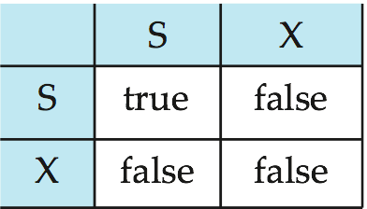
Lock-Based Protocols (Cont.)
Lock-compatibility matrix
A transaction may be granted a lock on an item if the requested lock is compatible with locks already held on the item by other transactions.
Any number of transactions can hold shared locks on an item,
  but if any transaction holds an exclusive on the item no other transaction may hold any lock on the item.
If a lock cannot be granted, the requesting transaction is made to wait till all incompatible locks held by other transactions have been released. The lock is then granted.

Slide 17
Lock-Based Protocols (Cont.)
Procedures of Ti’s executing to access a data item Q
  (1) other operations in T_{i}
  (2) request a lock S(Q) or X(Q), by the primitive lock-S(Q) or lock-X(Q)
  (3) wait for concurrency-control manager’s granting of the lock requested;
  (4) whenever obtaining the lock, make access on Q;
  (5) after finishing data access on Q, release lock on Q, by unlock-S(Q) or unlock-X(Q);
  (6) other operations;

Slide 18
T_{i}
T_{j}
lock-X(Q)
read(Q)
lock-S(R)
read(R)
unlock(R)
write(Q)
lock-X(R)
waiting
…
obtaining the lock
read(R)

Slide 19
Lock-Based Protocols (Cont.)
Example of a transaction performing locking:
T₂: lock-S(A);
read (A);
unlock(A);
lock-S(B);
read (B);
unlock(B);
display(A+B)
Locking as above is not sufficient to guarantee serializability — if A and B get updated in-between the read of A and B, the displayed sum would be wrong.
A locking protocol is a set of rules followed by all transactions while requesting and releasing locks. Locking protocols restrict the set of possible schedules.

Slide 20
Lock-Based Protocols (Cont.)
一级封锁协议: 事务T在修改数据R之前必须先对其加X锁, 直到事务结束才释放
  可防止丢失修改, 如果只是读数据, 不需加锁
  不能保证可重复读, 不读脏数据
二级封锁协议: 一级封锁协议加上事务T在读取数据R之前必须先对其加S锁, 读完后即可释放
  可防止读脏数据, 丢失修改
  不能保证可重复读
三级封锁协议: 一级封锁协议加上事务T在读取数据R之前必须先对其加S锁, 直到事务结束才释放
  可防止读脏数据, 丢失修改
  能保证可重复读

Slide 21

Pitfalls of Lock-Based Protocols
Consider the partial schedule
Neither T₃ nor T₄ can make progress — executing lock-S(B) causes T₄ to wait for T₃ to release its lock on B, while executing lock-X(A) causes T₃ to wait for T₄ to release its lock on A.
Such a situation is called a deadlock.
  To handle a deadlock one of T₃ or T₄ must be rolled back and its locks released.

Slide 22
Pitfalls(陷阱） of Lock-Based Protocols (Cont.)
The potential for deadlock exists in most locking protocols. Deadlocks are a necessary evil.
Starvation is also possible if concurrency control manager is badly designed. For example:
  A transaction may be waiting for an X-lock on an item, while a sequence of other transactions request and are granted an S-lock on the same item.
  The same transaction is repeatedly rolled back due to deadlocks.
Concurrency control manager can be designed to prevent starvation.

Slide 23
使用封锁机制解决丢失修改问题
例：
没有丢失修改
T₁ | T₂
① Xlock A
② R(A)=16
 | Xlock A
③ A←A-1 | 等待
W(A)=15 | 等待
Commit | 等待
Unlock A | 等待
④ | 获得Xlock A
 | R(A)=15
 | A←A-1
⑤ | W(A)=14
 | Commit
 | Unlock A
事务T1在读A进行修改之前先对A加X锁
当T2再请求对A加X锁时被拒绝
T2只能等待T1释放A上的锁后T2获得对A的X锁
这时T2读到的A已经是T1更新过的值15
T2按此新的A值进行运算，并将结果值A=14送回到磁盘。避免了丢失T1的更新。

Slide 24
使用封锁机制解决不可重复读问题
T₁ | T₂
① Slock A
Slock B
R(A)=50
R(B)=100
求和=150
② | Xlock B
 | 等待
 | 等待
③ R(A)=50 | 等待
R(B)=100 | 等待
求和=150 | 等待
Commit | 等待
Unlock A | 等待
Unlock B | 等待
④ | 获得XlockB
 | R(B)=100
 | B←B*2
⑤ | W(B)=200
 | Commit
 | Unlock B
可重复读
事务T1在读A，B之前，先对A，B加S锁
其他事务只能再对A，B加S锁，而不能加X锁，即其他事务只能读A，B，而不能修改
当T2为修改B而申请对B的X锁时被拒绝只能等待T1释放B上的锁
T1为验算再读A，B，这时读出的B仍是100，求和结果仍为150，即可重复读
T1结束才释放A，B上的S锁。T2才获得对B的X锁

Slide 25
使用封锁机制解决读“脏”数据问题
不读“脏”数据
例
T₁ | T₂
① Xlock C
R(C)=100
C←C*2
W(C)=200
② | Slock C
 | 等待
③ ROLLBACK | 等待
(C恢复为100) | 等待
Unlock C | 等待
④ | 获得Slock C
 | R(C)=100
⑤ | Commit C
 | Unlock C
事务T1在对C进行修改之前，先对C加X锁，修改其值后写回磁盘
T2请求在C上加S锁，因T1已在C上加了X锁，T2只能等待
T1因某种原因被撤销，C恢复为原值100
T1释放C上的X锁后T2获得C上的S锁，读C=100。避免了T2读“脏”数据

Slide 26
The Two-Phase Locking Protocol
The basic two-phase locking (2PL) protocol
  A transaction T must hold a lock on an item x in the appropriate mode before T accesses x.
  If a conflicting lock on x is being held by another transaction, T waits.
  Once T releases a lock, it cannot obtain any other lock subsequently.
This is a protocol which ensures conflict-serializable schedules.
Phase 1: Growing Phase(obtaining locks)
  transaction may obtain locks
  transaction may not release locks
Phase 2: Shrinking Phase (releasing locks)
  transaction may release locks
  transaction may not obtain locks
The protocol assures serializability. It can be proved that the transactions can be serialized in the order of their lock points (i.e., the point where a transaction acquired its final lock).

Slide 27
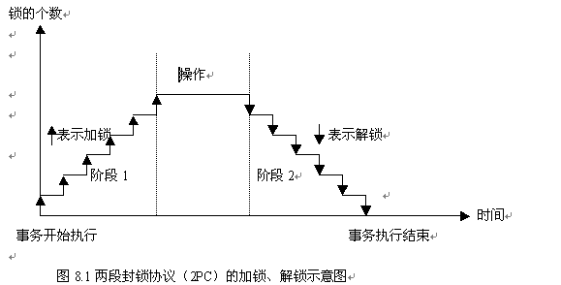
The Two-Phase Locking Protocol

Slide 28
The Two-Phase Locking Protocol
T₅
Lock-X(A)
read (A)
Lock-S(B)
read (B)
Unlock (B)
write (A)
Unlock (A)
growing
phase
lock
point
Shrinking
phase
Partial schedule under two-phase locking

Slide 29
T₅
Lock-X(A)
read (A)
Lock-S(B)
read (B)
Unlock (B)
write (A)
Unlock (A)
T₆’
Lock-X(B)
read (B)
write (B)
Unlock (B)
LP5
Lock-X(B)
waiting
LP6’
Fig. 16.0.1 A concurrent schedule S3 under 2PL protocol constraints

Slide 30
!! Properties of 2PL
2PL guarantees conflict serializability, i.e. generates conflict serializable concurrent schedules
2PL does not ensure freedom from deadlock
2PL does not avoid cascading rollback

Slide 31
How to construct the schedules
in line with 2PL
/*给定若干事务, 构造满足2PL的并发调度S！！
  为各事务添加加锁和解锁操作，各事务应满足2PL要求，即事务内部分为生长和收缩2个阶段
  根据各事务的锁点位置和锁的互斥性 (相容关系)，安排各事务的并发执行
  S中各事务的growing phase和shrinking phase 应尽可能错开，不允许访问同一数据的2个事务（冲突事务）同时处于growing phase
E.g. A concurrent schedule S4 in Fig.16.0.2

Slide 32
T₅
Lock-X(A)
read (A)
Lock-S(B)
read (B)
Unlock (B)
write (A)
Unlock (A)
T₆’
Lock-X(B)
read (B)
write (B)
Unlock (B)
G
G
S
S
S4 is equivalent to <T6’;T5>
Fig. 16.0.2 A concurrent schedule S4 under 2PL protocol constraints

Slide 33
How to construct the schedules
in line with 2PL (cont.)
E.g. Construct a concurrent schedule that is equivalent to < T7;T8 >
  step1. 分别为T7和T8加锁操作, 构成T7’和T8’
T₇
read (A)
read (B)
write (A)
T₇’
Lock-X(A)
read (A)
Lock-S(B)
read (B)
Unlock (B)
write (A)
Unlock (A)
T₈
read (B)
write (B)
read (C)
T₈’
Lock-X(B)
read (B)
Lock-S(C)
write (B)
read (C)
Unlock (B)
Unlock (C)
Fig.16.0.3-1 A concurrent schedule S5

Slide 34
  step2. 根据锁的相容性构造调度，假设T₇’的锁点先于T₈’的锁点
T₇’
Lock-X(A)
read (A)
Lock-S(B)
read (B)
Unlock (B)
write (A)
Unlock (A)
T₈’
Lock-X(B)
read (B)
Lock-S(C)
write (B)
read (C)
Unlock (B)
Unlock (C)
Fig.16.0.3-2 A concurrent schedule S5

Slide 35
The Two-Phase Locking Protocol (Cont.)
Two-phase locking does not ensure freedom from deadlocks.
Cascading roll-back is possible under two-phase locking. To avoid this, follow a modified protocol called strict two-phase locking. Here a transaction must hold all its exclusive locks till it commits/aborts., that is, all X-locks can only be unlocked at the end of the transaction
Rigorous(强制的） two-phase locking is even stricter: here all locks are held till commit/abort. In this protocol transactions can be serialized in the order in which they commit.

Slide 36
The Two-Phase Locking Protocol (Cont.)
There can be conflict serializable schedules that cannot be obtained if two-phase locking is used.
However, in the absence of extra information (e.g., ordering of access to data), two-phase locking is needed for conflict serializability in the following sense:
Given a transaction T_{i} that does not follow two-phase locking, we can find a transaction T_{j} that uses two-phase locking, and a schedule for T_{i} and T_{j} that is not conflict serializable.

Slide 37
Lock Conversions
Two-phase locking with lock conversions:
– First Phase:
  can acquire a lock-S on item
  can acquire a lock-X on item
  can convert a lock-S to a lock-X (upgrade)
– Second Phase:
  can release a lock-S
  can release a lock-X
  can convert a lock-X to a lock-S (downgrade)
This protocol assures serializability. But still relies on the programmer to insert the various locking instructions.

Slide 38
Automatic Acquisition（获得) of Locks
A transaction T_{i} issues the standard read/write instruction, without explicit locking calls.
The operation read(D) is processed as:
if T_{i} has a lock on D
then
read(D)
else begin
if necessary wait until no other
transaction has a lock-X on D
grant T_{i} a lock-S on D;
read(D)
end

Slide 39
Automatic Acquisition of Locks (Cont.)
write(D) is processed as:
if T_{i} has a lock-X on D
then
write(D)
else begin
if necessary wait until no other trans. has any lock on D,
if T_{i} has a lock-S on D
then
upgrade lock on D to lock-X
else
grant T_{i} a lock-X on D
write(D)
end;
All locks are released after commit or abort

Slide 40

Deadlock Handling
Consider the following two transactions:
T₁: write (X) T₂: write(Y)
write(Y) write(X)
Schedule with deadlock

Slide 41
Deadlock Handling
System is deadlocked if there is a set of transactions such that every transaction in the set is waiting for another transaction in the set.
Deadlock prevention protocols ensure that the system will never enter into a deadlock state. Some prevention strategies:
  Require that each transaction locks all its data items before it begins execution (predeclaration).
  Impose partial ordering of all data items and require that a transaction can lock data items only in the order specified by the partial order (graph-based protocol).

Slide 42
More Deadlock Prevention Strategies
Following schemes use transaction timestamps for the sake of deadlock prevention alone.
wait-die scheme — non-preemptive
  older transaction may wait for younger one to release data item. Younger transactions never wait for older ones; they are rolled back instead.
  a transaction may die several times before acquiring needed data item
wound-wait scheme — preemptive
  older transaction wounds (forces rollback) of younger transaction instead of waiting for it. Younger transactions may wait for older ones.
  may be fewer rollbacks than wait-die scheme

Slide 43
Deadlock prevention (Cont.)
Both in wait-die and in wound-wait schemes, a rolled back transactions is restarted with its original timestamp. Older transactions thus have precedence over newer ones, and starvation is hence avoided.
Timeout-Based Schemes:
  a transaction waits for a lock only for a specified amount of time. After that, the wait times out and the transaction is rolled back.
  thus deadlocks are not possible
  simple to implement; but starvation is possible. Also difficult to determine good value of the timeout interval.

Slide 44
Deadlock Detection
Deadlocks can be described as a wait-for graph, which consists of a pair G = (V,E),
  V is a set of vertices (all the transactions in the system)
  E is a set of edges; each element is an ordered pair T_{i} →T_{j}.
If T_{i} → T_{j} is in E, then there is a directed edge from T_{i} to T_{j}, implying that T_{i} is waiting for T_{j} to release a data item.
When T_{i} requests a data item currently being held by T_{j}, then the edge T_{i} T_{j} is inserted in the wait-for graph. This edge is removed only when T_{j} is no longer holding a data item needed by T_{i}.
The system is in a deadlock state if and only if the wait-for graph has a cycle. Must invoke a deadlock-detection algorithm periodically to look for cycles.

Slide 45
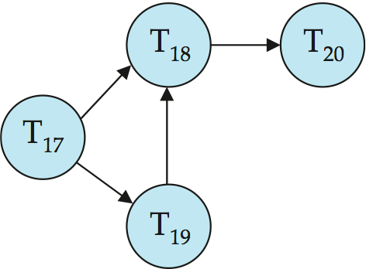
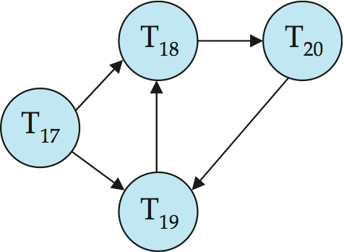
Deadlock Detection (Cont.)
Wait-for graph without a cycle
Wait-for graph with a cycle

Slide 46
Deadlock Recovery
When deadlock is detected:
  Some transaction will have to rolled back (made a victim) to break deadlock. Select that transaction as victim that will incur minimum cost.
  Rollback -- determine how far to roll back transaction
    Total rollback: Abort the transaction and then restart it.
    More effective to roll back transaction only as far as necessary to break deadlock.
  Starvation happens if same transaction is always chosen as victim. Include the number of rollbacks in the cost factor to avoid starvation

Slide 47
Multiple Granularity
Allow data items to be of various sizes and define a hierarchy of data granularities, where the small granularities are nested within larger ones.
Can be represented graphically as a tree (but don't confuse with tree-locking protocol)
When a transaction locks a node in the tree explicitly, it implicitly locks all the node's descendents in the same mode.
Granularity of locking (level in tree where locking is done):
  fine granularity (lower in tree): high concurrency, high locking overhead
  coarse granularity (higher in tree): low locking overhead, low concurrency

Slide 48
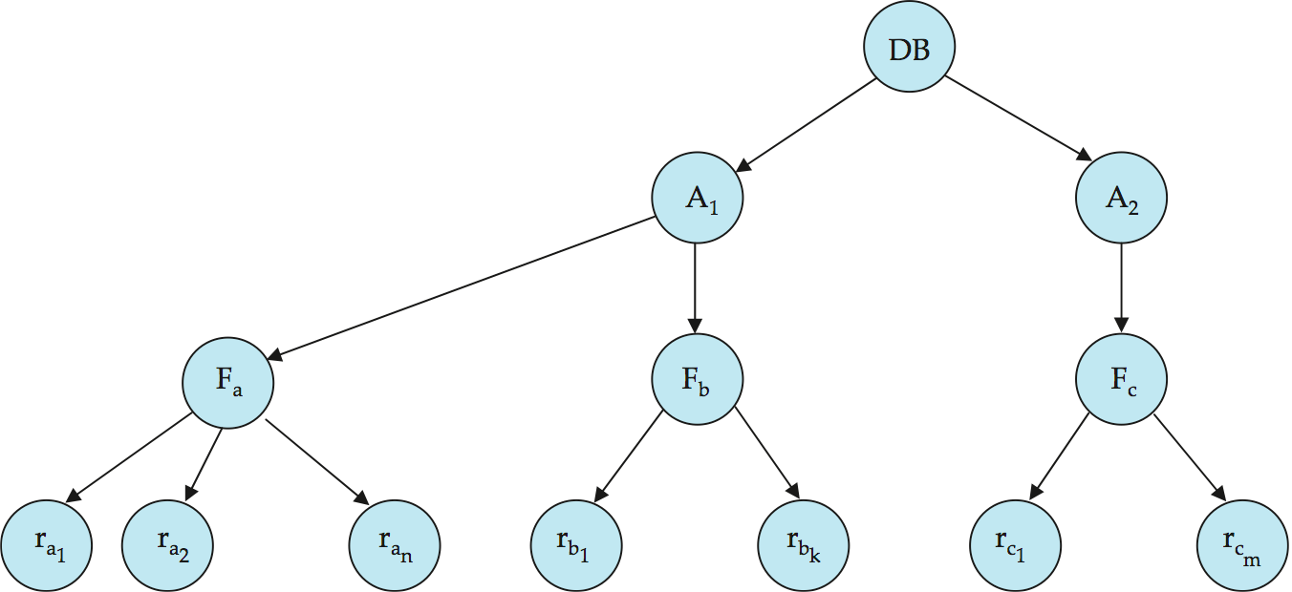
Example of Granularity Hierarchy
The levels, starting from the coarsest (top) level are:
  database
  area(e.g. page in SQL Server)
  file
  record

Slide 49


transaction T_{i} :
update Student
set grade=4
where age>10
transaction T_{j} :
update Student
set grade=6
where age < 5
表级锁
表级锁
Student
行级锁
grade | ID | name | age
1 | 21 | 1 | 12
2 | 22 | 2 | 7
3 | 0 | 3 | 8
6 | 4 | 3 | 1
…………
12 | 2 | 7 | 3
23 | 4 | 8 | 9
行级锁

Slide 50
Intention Lock Modes
In addition to S and X lock modes, there are three additional lock modes with multiple granularity:
  intention-shared (IS): indicates explicit locking at a lower level of the tree but only with shared locks.
  intention-exclusive (IX): indicates explicit locking at a lower level with exclusive or shared locks
  shared and intention-exclusive (SIX): the subtree rooted by that node is locked explicitly in shared mode and explicit locking is being done at a lower level with exclusive-mode locks.
Intention locks allow a higher level node to be locked in S or X mode without having to check all descendent nodes.

Slide 51
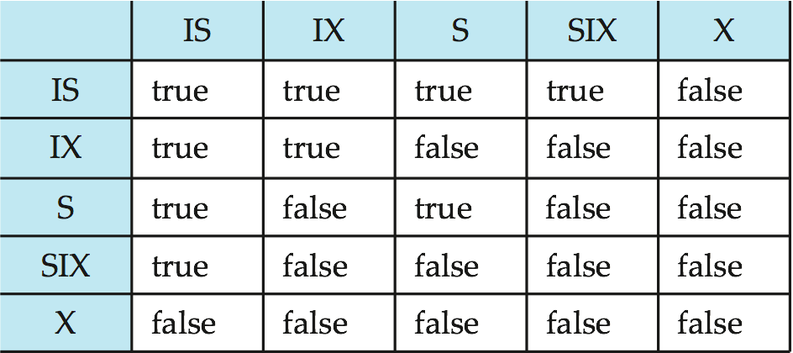
Compatibility Matrix with Intention Lock Modes
The compatibility matrix for all lock modes is:

Slide 52
Multiple Granularity Locking Scheme
Transaction T_{i} can lock a node Q, using the following rules:
  The lock compatibility matrix must be observed.
  The root of the tree must be locked first, and may be locked in any mode.
  A node Q can be locked by T_{i} in S or IS mode only if the parent of Q is currently locked by T_{i} in either IX or IS mode.
  A node Q can be locked by T_{i} in X, SIX, or IX mode only if the parent of Q is currently locked by T_{i} in either IX or SIX mode.
  T_{i} can lock a node only if it has not previously unlocked any node (that is, T_{i} is two-phase).
  T_{i} can unlock a node Q only if none of the children of Q are currently locked by T_{i}.
Observe that locks are acquired in root-to-leaf order, whereas they are released in leaf-to-root order.

Slide 53
Timestamp-Based Protocols
Each transaction is issued a timestamp when it enters the system. If an old transaction T_{i} has time-stamp TS(T_{i}), a new transaction T_{j} is assigned time-stamp TS(T_{j}) such that TS(T_{i}) <TS(T_{j}).
The protocol manages concurrent execution such that the time-stamps determine the serializability order.
In order to assure such behavior, the protocol maintains for each data Q two timestamp values:
  W-timestamp(Q) is the largest time-stamp of any transaction that executed write(Q) successfully.
  R-timestamp(Q) is the largest time-stamp of any transaction that executed read(Q) successfully.

Slide 54
Timestamp-Based Protocols (Cont.)
The timestamp ordering protocol ensures that any conflicting read and write operations are executed in timestamp order.
Suppose a transaction T_{i} issues a read(Q):
  If TS(T_{i}) ≤ W-timestamp(Q), then T_{i} needs to read a value of Q that was already overwritten.
    Hence, the read operation is rejected, and T_{i} is rolled back.
  If TS(T_{i})≥ W-timestamp(Q), then the read operation is executed, and R-timestamp(Q) is set to max(R-timestamp(Q), TS(T_{i})).

Slide 55
Timestamp-Based Protocols (Cont.)
Suppose that transaction T_{i} issues write(Q).
  If TS(T_{i}) < R-timestamp(Q), then the value of Q that T_{i} is producing was needed previously, and the system assumed that that value would never be produced.
    Hence, the write operation is rejected, and T_{i} is rolled back.
  If TS(T_{i}) < W-timestamp(Q), then T_{i} is attempting to write an obsolete value of Q.
    Hence, this write operation is rejected, and T_{i} is rolled back.
  Otherwise, the write operation is executed, and W-timestamp(Q) is set to TS(T_{i}).

Slide 56

Example Use of the Protocol
A partial schedule for several data items for transactions with
timestamps 1, 2, 3, 4, 5

Slide 57

Correctness of Timestamp-Ordering Protocol
The timestamp-ordering protocol guarantees serializability since all the arcs in the precedence graph are of the form:
Thus, there will be no cycles in the precedence graph.
Timestamp protocol ensures freedom from deadlock as no transaction ever waits.
But the schedule may not be cascade-free, and may not even be recoverable.

Slide 58
Recoverability and Cascade Freedom
Problem with timestamp-ordering protocol:
  Suppose T_{i} aborts, but T_{j} has read a data item written by T_{i}
  Then T_{j} must abort; if T_{j} had been allowed to commit earlier, the schedule is not recoverable.
  Further, any transaction that has read a data item written by T_{j} must abort
  This can lead to cascading rollback --- that is, a chain of rollbacks
Solution 1:
  A transaction is structured such that its writes are all performed at the end of its processing
  All writes of a transaction form an atomic action; no transaction may execute while a transaction is being written
  A transaction that aborts is restarted with a new timestamp
Solution 2: Limited form of locking: wait for data to be committed before reading it
Solution 3: Use commit dependencies to ensure recoverability

Slide 59
Snapshot Isolation
Motivation: Decision support queries that read large amounts of data have concurrency conflicts with OLTP transactions that update a few rows
  Poor performance results
Solution 1: Give logical “snapshot” of database state to read only transactions, read-write transactions use normal locking
  Multiversion 2-phase locking
  Works well, but how does system know a transaction is read only?
Solution 2: Give snapshot of database state to every transaction, updates alone use 2-phase locking to guard against concurrent updates
  Problem: variety of anomalies such as lost update can result
  Partial solution: snapshot isolation level (next slide)
    Proposed by Berenson et al, SIGMOD 1995
    Variants implemented in many database systems
      E.g., Oracle, PostgreSQL, SQL Server 2005

Slide 60
Snapshot Isolation
A transaction T1 executing with Snapshot Isolation
  takes snapshot of committed data at start
  always reads/modifies data in its own snapshot
  updates of concurrent transactions are not visible to T1
  writes of T1 complete when it commits
  First-committer-wins rule:
    Commits only if no other concurrent transaction has already written data that T1 intends to write.
T1 | T2 | T3
W(Y := 1) Commit
 | Start R(X) → 0 R(Y)→ 1
 |  | W(X:=2) W(Z:=3) Commit
 | R(Z) → 0 R(Y) → 1 W(X:=3) Commit-Req Abort
Concurrent updates not visible
Own updates are visible
Not first-committer of X
Serialization error, T2 is rolled back

Slide 61
Benefits of SI
Reading is never blocked
  and also doesn’t block other txns activities
Performance similar to Read Committed
Avoids the usual anomalies
  No dirty read
  No lost update
  No non-repeatable read
  Predicate based selects are repeatable (no phantoms)
Problems with SI
  SI does not always give serializable executions
    Serializable: among two concurrent txns, one sees the effects of the other
    In SI: neither sees the effects of the other
  Result: Integrity constraints can be violated

Slide 62
Snapshot Isolation
E.g., of problem with SI
  T1: x:=y
  T2: y:= x
  Initially x = 3 and y = 17
    Serial execution: x = ??, y = ??
    if both transactions start at the same time, with snapshot isolation: x = ?? , y = ??
Called skew write
Skew also occurs with inserts
  E.g.,:
    Find max order number among all orders
    Create a new order with order number = previous max + 1

Slide 63
Snapshot Isolation Anomalies
SI breaks serializability when txns modify different items, each based on a previous state of the item the other modified
  Not very common in practice
    E.g., the TPC-C benchmark runs correctly under SI
    when txns conflict due to modifying different data, there is usually also a shared item they both modify too (like a total quantity) so SI will abort one of them
  But does occur
    Application developers should be careful about write skew
SI can also cause a read-only transaction anomaly, where read-only transaction may see an inconsistent state even if updaters are serializable
  We omit details

Slide 64
SI In Oracle and PostgreSQL
Warning: SI used when isolation level is set to serializable, by Oracle and PostgreSQL
  PostgreSQL’s implementation of SI described in Section 26.4.1.3
  Oracle implements “first updater wins” rule (variant of “first committer wins”)
    concurrent writer check is done at time of write, not at commit time
    Allows transactions to be rolled back earlier
  Neither supports true serializable execution
Can sidestep for specific queries by using select .. for update in Oracle and PostgreSQL
  Locks the data which is read, preventing concurrent updates
  E.g.,
    select max(orderno) from orders for update
    read value into local variable maxorder
    insert into orders (maxorder+1, …)

Slide 65
Insert and Delete Operations
If two-phase locking is used :
  A delete operation may be performed only if the transaction deleting the tuple has an exclusive lock on the tuple to be deleted.
  A transaction that inserts a new tuple into the database is given an X-mode lock on the tuple
Insertions and deletions can lead to the phantom phenomenon.
  A transaction that scans a relation
    (e.g., find sum of balances of all accounts in Perryridge)
    and a transaction that inserts a tuple in the relation
    (e.g., insert a new account at Perryridge)
    (conceptually) conflict in spite of not accessing any tuple in common.
  If only tuple locks are used, non-serializable schedules can result
    E.g., the scan transaction does not see the new account, but reads some other tuple written by the update transaction

Slide 66
Insert and Delete Operations (Cont.)
The transaction scanning the relation is reading information that indicates what tuples the relation contains, while a transaction inserting a tuple updates the same information.
  The information should be locked.
One solution:
  Associate a data item with the relation, to represent the information about what tuples the relation contains.
  Transactions scanning the relation acquire a shared lock in the data item.
  Transactions inserting or deleting a tuple acquire an exclusive lock on the data item. (Note: locks on the data item do not conflict with locks on individual tuples.)
Above protocol provides very low concurrency for insertions/ deletions.
Index locking protocols provide higher concurrency while preventing the phantom phenomenon, by requiring locks
on certain index buckets.

Slide 67
Weak Levels of Consistency
Degree-two consistency: differs from two-phase locking in that S-locks may be released at any time, and locks may be acquired at any time
  X-locks must be held till end of transaction
  Serializability is not guaranteed, programmer must ensure that no erroneous database state will occur]
Cursor stability:
  For reads, each tuple is locked, read, and lock is immediately released
  X-locks are held till end of transaction
  Special case of degree-two consistency

Slide 68
Weak Levels of Consistency in SQL
SQL allows non-serializable executions
  Serializable: is the default
  Repeatable read: allows only committed records to be read, and repeating a read should return the same value (so read locks should be retained)
    However, the phantom phenomenon need not be prevented
      T1 may see some records inserted by T2, but may not see others inserted by T2
  Read committed: same as degree two consistency, but most systems implement it as cursor-stability
  Read uncommitted: allows even uncommitted data to be read
In many database systems, read committed is the default consistency level
  has to be explicitly changed to serializable when required
    set isolation level serializable

Slide 69
Index Locking Protocol
Index locking protocol:
  Every relation must have at least one index.
  A transaction can access tuples only after finding them through one or more indices on the relation
  A transaction T_{i} that performs a lookup must lock all the index leaf nodes that it accesses, in S-mode
    Even if the leaf node does not contain any tuple satisfying the index lookup (e.g., for a range query, no tuple in a leaf is in the range)
  A transaction T_{i} that inserts, updates or deletes a tuple t_{i} in a relation r
    must update all indices to r
    must obtain exclusive locks on all index leaf nodes affected by the insert/update/delete
  The rules of the two-phase locking protocol must be observed
Guarantees that phantom phenomenon won’t occur

Slide 70
Concurrency in Index Structures
Indices are unlike other database items in that their only job is to help in accessing data.
Index-structures are typically accessed very often, much more than other database items.
  Treating index-structures like other database items, e.g., by 2-phase locking of index nodes can lead to low concurrency.
There are several index concurrency protocols where locks on internal nodes are released early, and not in a two-phase fashion.
  It is acceptable to have nonserializable concurrent access to an index as long as the accuracy of the index is maintained.
    In particular, the exact values read in an internal node of a
    B⁺-tree are irrelevant so long as we land up in the correct leaf node.

Slide 71
Concurrency in Index Structures (Cont.)
Example of index concurrency protocol:
Use crabbing instead of two-phase locking on the nodes of the B⁺-tree, as follows. During search/insertion/deletion:
  First lock the root node in shared mode.
  After locking all required children of a node in shared mode, release the lock on the node.
  During insertion/deletion, upgrade leaf node locks to exclusive mode.
  When splitting or coalescing requires changes to a parent, lock the parent in exclusive mode.
Above protocol can cause excessive deadlocks
  Searches coming down the tree deadlock with updates going up the tree
  Can abort and restart search, without affecting transaction
Better protocols are available; see Section 16.9 for one such protocol, the B-link tree protocol
  Intuition: release lock on parent before acquiring lock on child
    And deal with changes that may have happened between lock release and acquire

Slide 72
Next-Key Locking
Index-locking protocol to prevent phantoms required locking entire leaf
  Can result in poor concurrency if there are many inserts
Alternative: for an index lookup
  Lock all values that satisfy index lookup (match lookup value, or fall in lookup range)
  Also lock next key value in index
  Lock mode: S for lookups, X for insert/delete/update
Ensures that range queries will conflict with inserts/deletes/updates
  Regardless of which happens first, as long as both are concurrent

Slide 73
End of Chapter
Thanks to Alan Fekete and Sudhir Jorwekar for Snapshot Isolation examples

Slide 74

Snapshot Read
Concurrent updates invisible to snapshot read

Slide 75

Snapshot Write: First Committer Wins
  Variant: “First-updater-wins”
    Check for concurrent updates when write occurs
    (Oracle uses this plus some extra features)
    Differs only in when abort occurs, otherwise equivalent

Slide 76
Figure 15.01

Slide 77
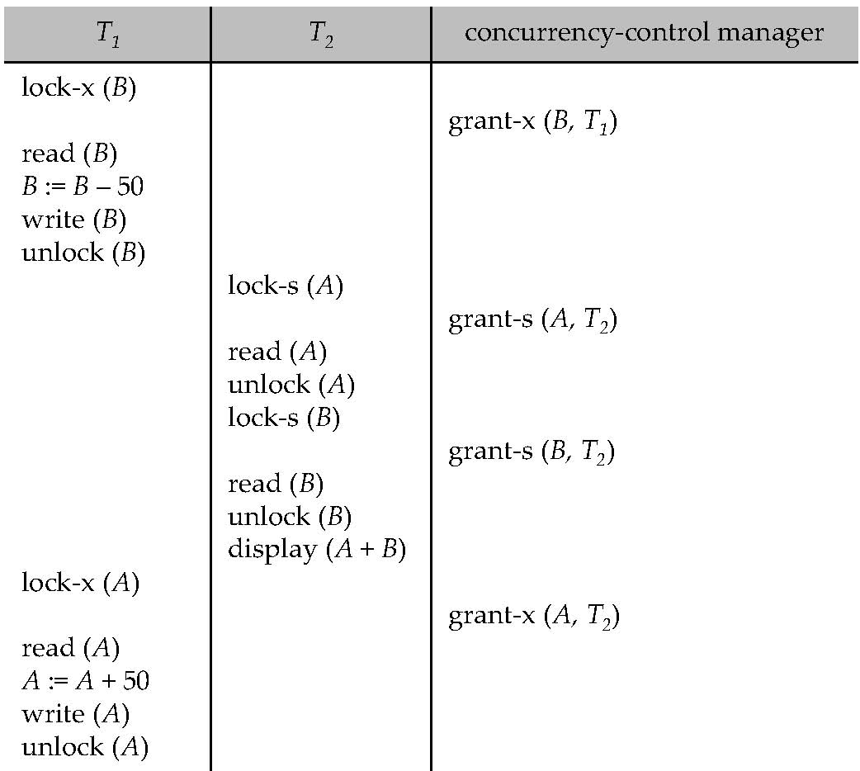
Figure 15.04

Slide 78
Figure 15.07

Slide 79
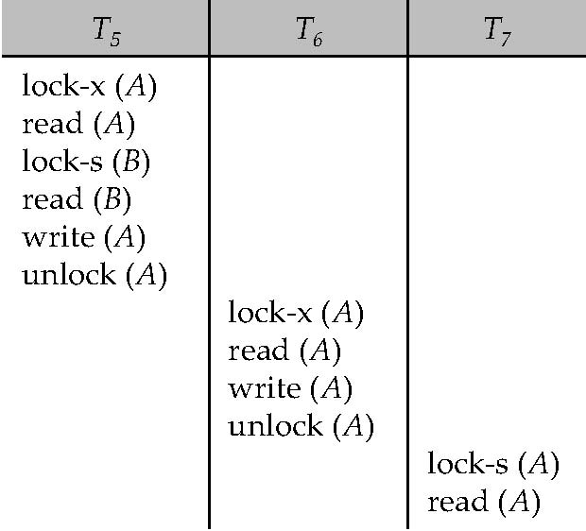
Figure 15.08

Slide 80
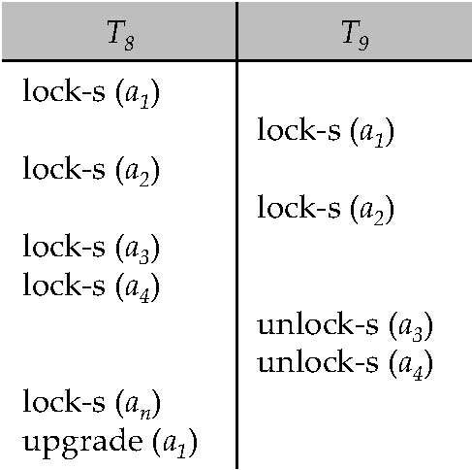
Figure 15.09

Slide 81
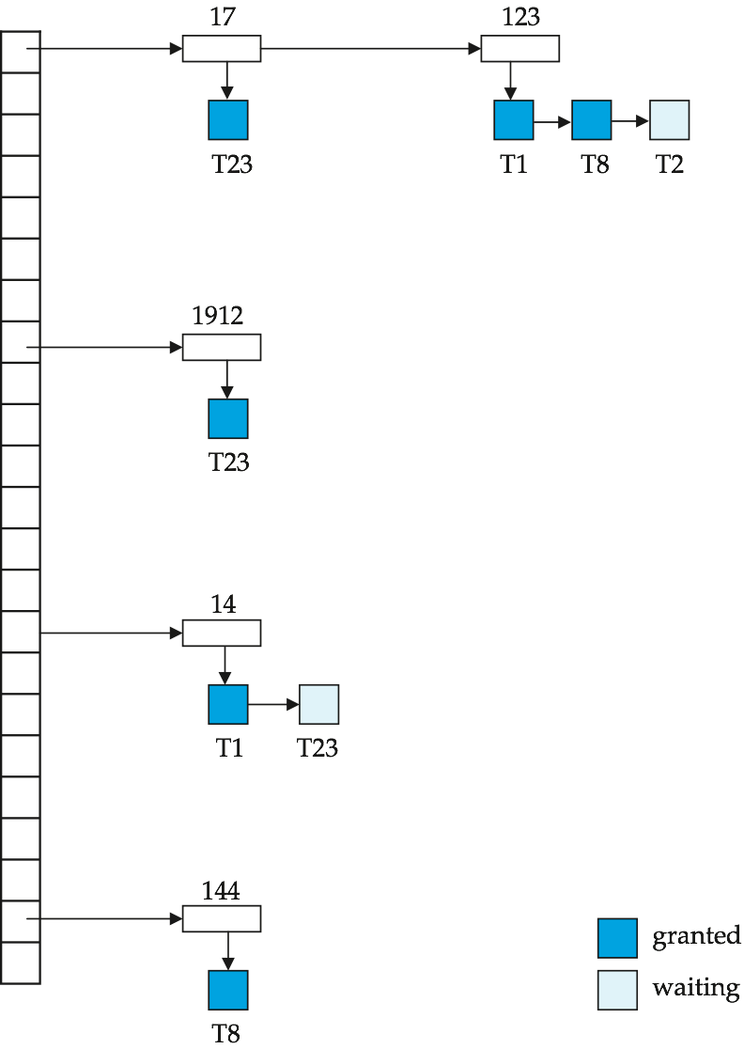
Figure 15.10

Slide 82
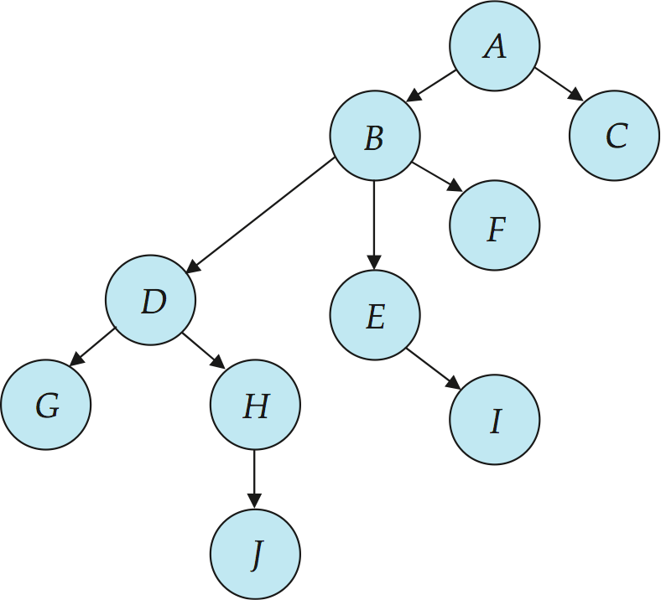
Figure 15.11

Slide 83
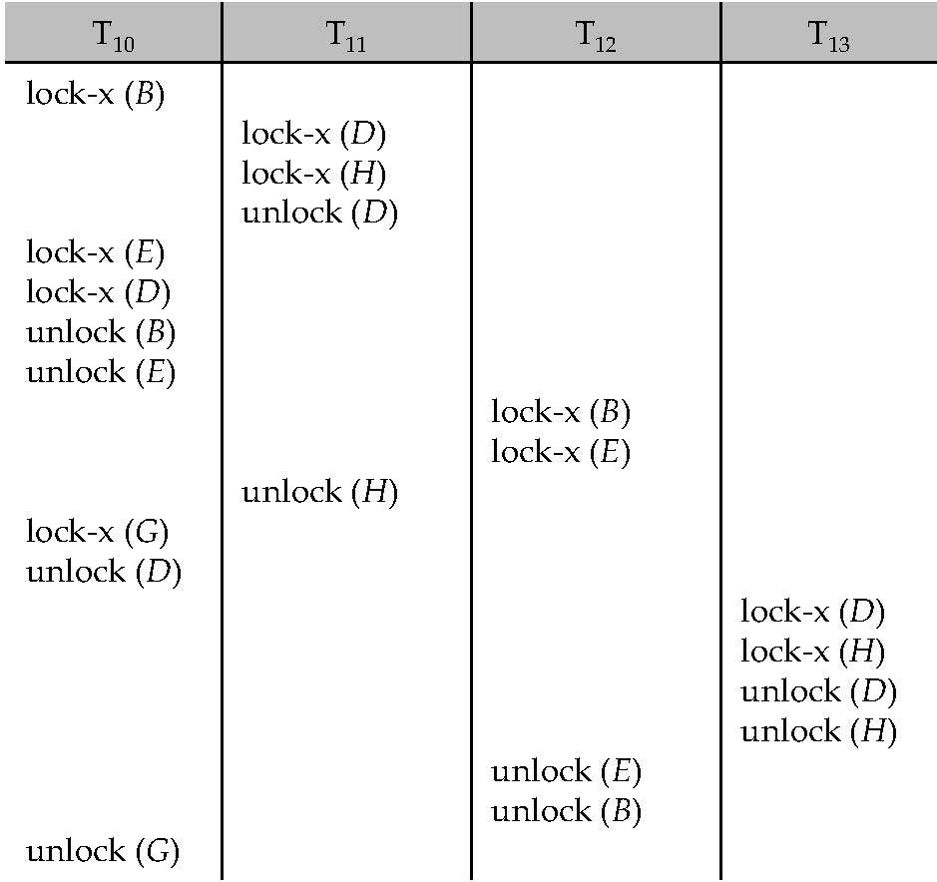
Figure 15.12

Slide 84
Figure 15.13

Slide 85
Figure 15.14

Slide 86
Figure 15.15

Slide 87
Figure 15.16

Slide 88
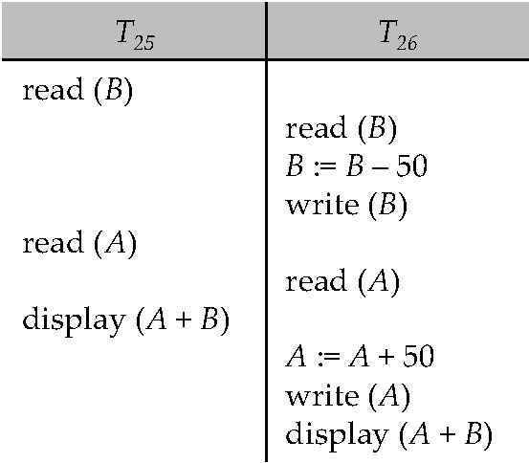
Figure 15.17

Slide 89
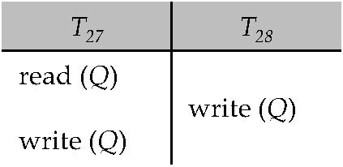
Figure 15.18

Slide 90

Figure 15.19

Slide 91
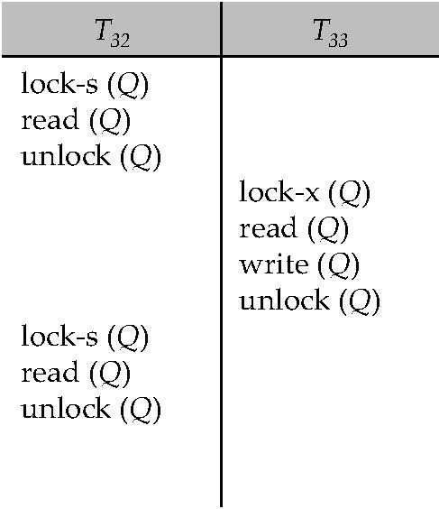
Figure 15.20

Slide 92
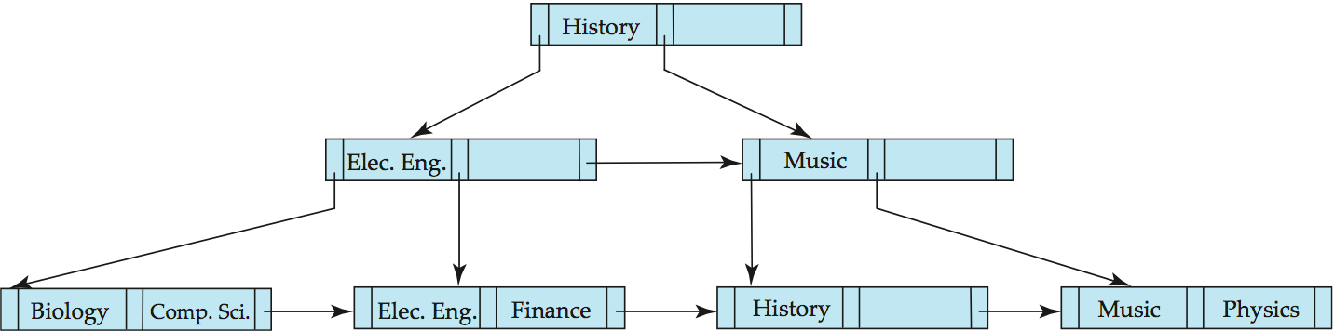
Figure 15.21

Slide 93
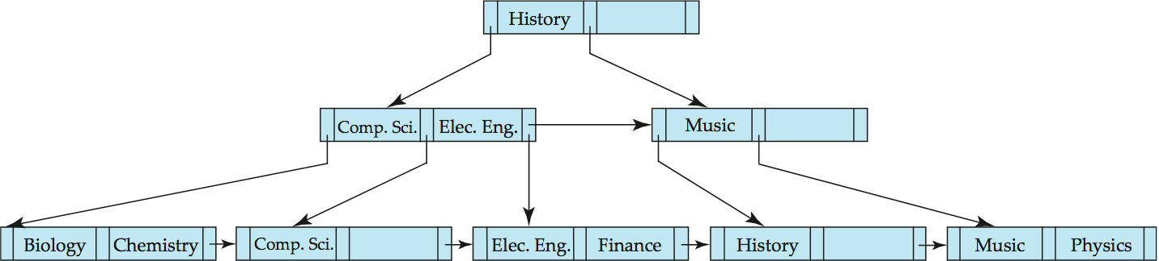
Figure 15.22

Slide 94
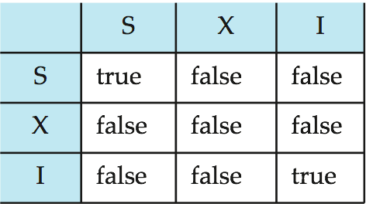
Figure 15.23

Slide 95

Figure in-15.1

